Slide 1
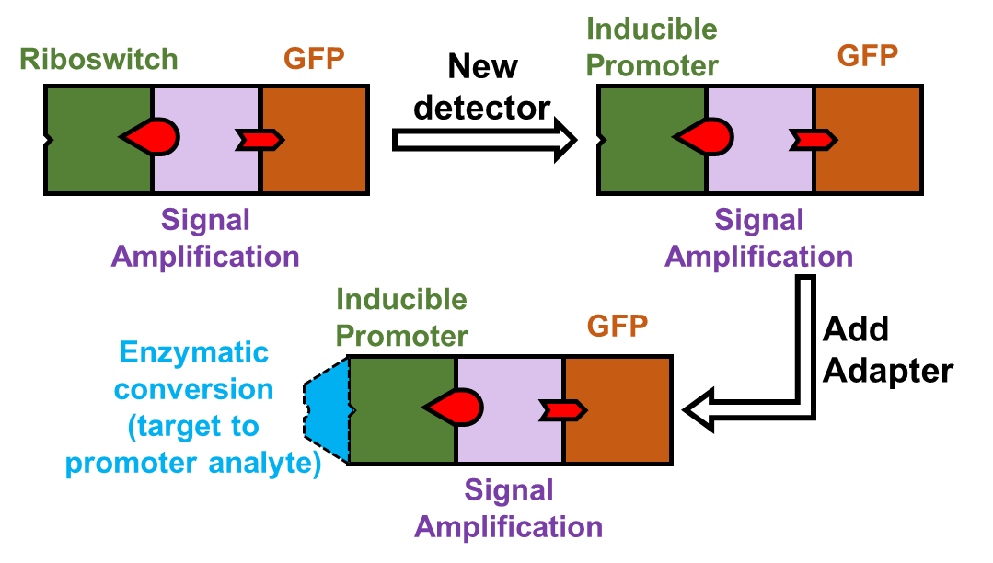
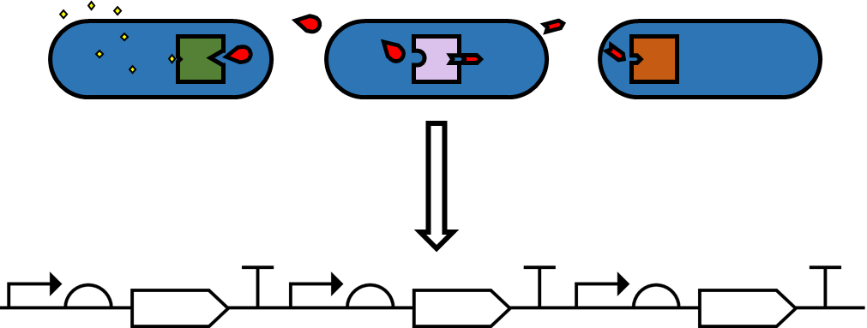
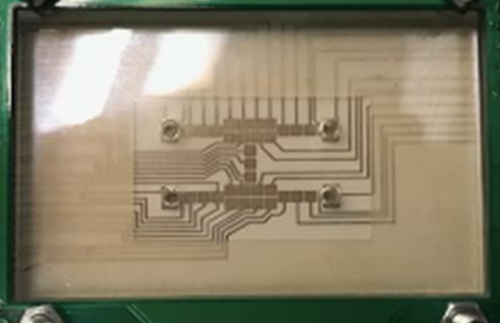
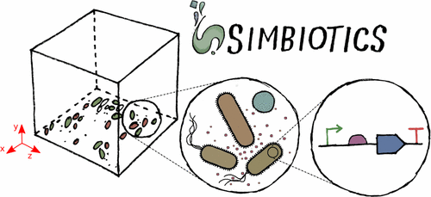
omniSense: A Toolbox for Aiding Biosensor Development
Logo
Newcastle iGEM’17 Team: Sophie Badger, Jessica Birt, Bradley Brown, Jack Cooper, Michaela Chapman, Declan Kohl, Marcia Pryce, Lais Takiguchi, Valeria Verrone, Shriansh Vyas, Anna Walsh, Evangeline Whittaker
Abstract
Email: newcastle.igem@outlook.com; Twitter: newcastle_igem
The omniSense Toolbox
Software
Biosensor Builder
Device Modules
Functional Modularity
Decision Tree
Devices which can be used to make a biosensor
Four types of modules:
Devices are functionally compatible as-is
No need to modify devices to develop new biosensors
Does the molecule bind a protein?
Detection
Processing
Recognises the target molecule
Provides extra functionality
Is the protein a transcription factor?
Yes
No
Does a degradation product bind a transcription factor?
Output
Adaptor
No
(Continues to questions regarding DNA and RNA based
Biosensors)
Response of the biosensor to the target
Links biochemical assays to the genetic circuit
Yes
No
Yes
Multicellular Biosensor Development Technique
(Generates Transcription Factor based model)
(Generates Protein Interaction-based model)
(Adds Biochemical Adaptor)
+ Additional questions about desired output and importance of processing devices.
Devices expressed in separate cells
Co-cultured to make a functional sensor
Variants made by swapping cell strains
The Biosensor Pipeline
Outputs:
Model: Consisting of Interchangable SBML models with connecting interfaces
Genetic output: SBOL design of genetic system
Other tools
Target
DropCode: a language for digital microfludics
Chassis
Automated Assembly Protocols
Cell-Free
Rapid assembly after development/testing
Engineering Lifecycle
We are working with a digital microfluidics chip manufacturer to develop a language to automate gene assembly and cell mixing.
E.coli
Biosensor
Systematic Review of Biosensors
Hardware
Human Practices
Tool
Enterprise
Product
Regulation/Uptake
Use
Modelling
Proof of Concept
Questions:
1) What effect will having components in different cells have on time taken to generate a response?
2) What is the optimum ratio of cells?
3) If components are in different species, eg. E. coli, Bacillus, Yeast, how will differing growth rates change component ratios over time?
Methods
Simbiotics:
Spatially explicit modelling platform for the design, simulation and analysis of bacterial populations [1]
References
[1] Naylor et al. (2017) Simbiotics: A Multiscale Integrative Platform for 3D Modeling of Bacterial Populations ACS Synthetic Biology
SPONSORS/ACKNOWLEDGEMENTS

