Slide 1
CFPS Update
14/06/2017

Slide 2
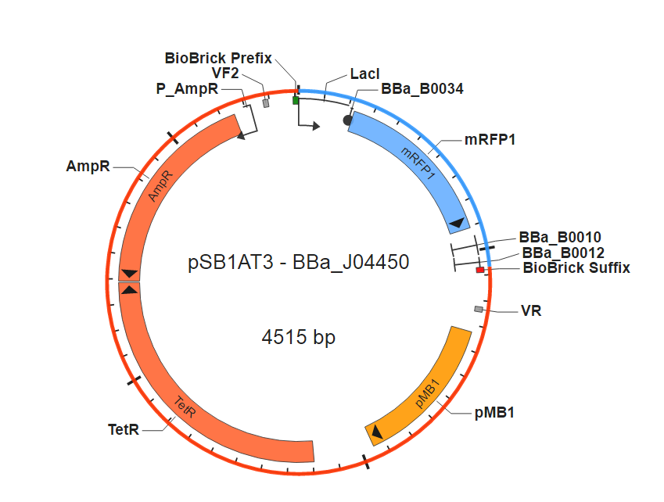
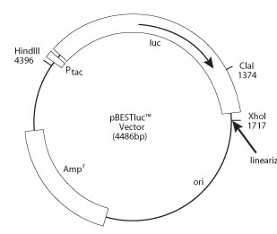
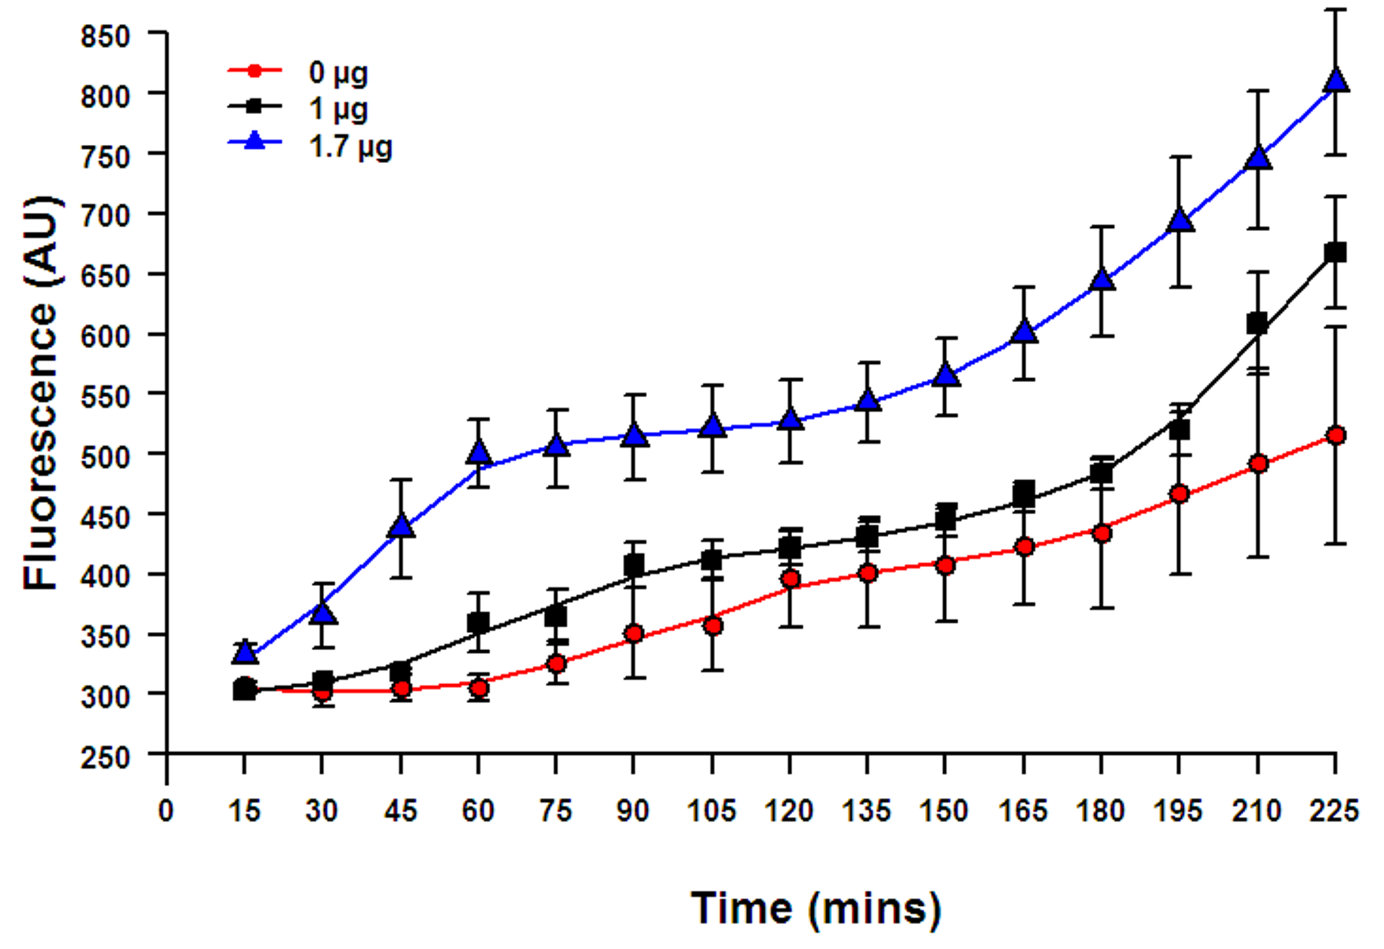
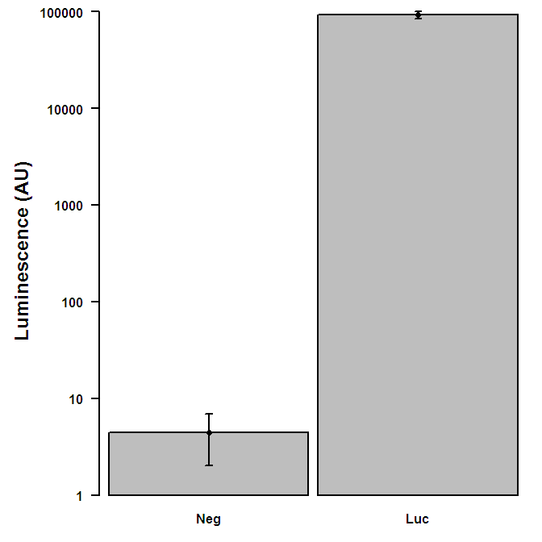
Commercial (Promega) S30 Circular Kit Testing
Express pSB1AT3-mRFP1 and pBEST-Luc

Slide 3
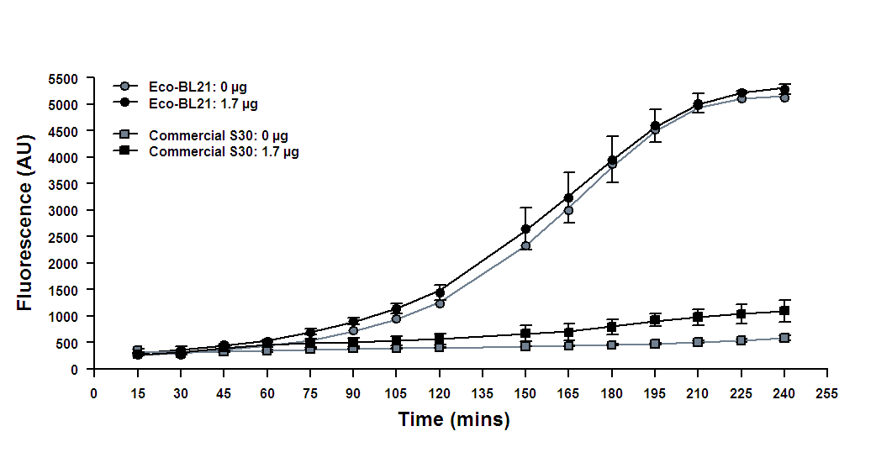
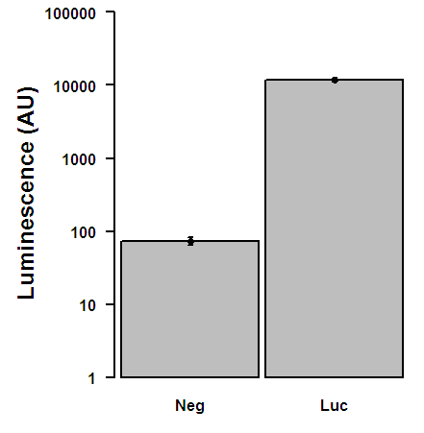
Initial E. coli BL21 CFPS system testing
Express pSB1AT3-mRFP1 and pBEST-Luc

Slide 4
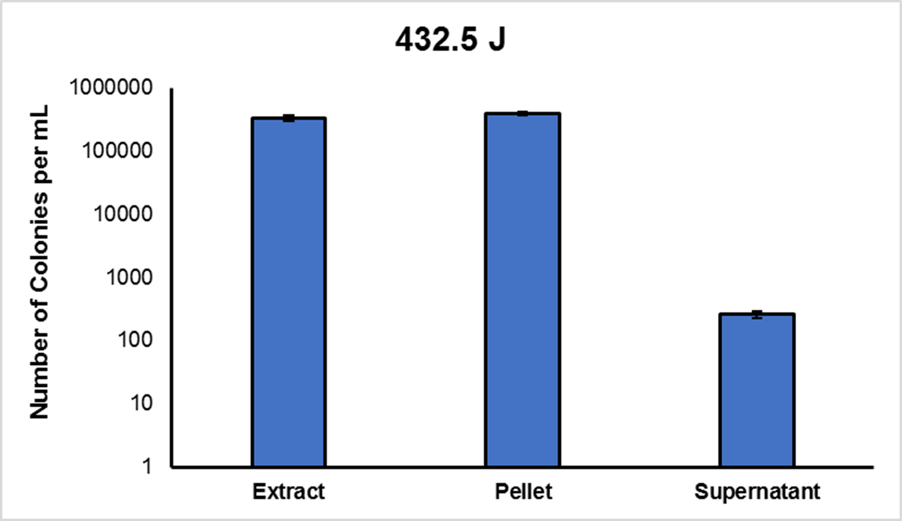
Troubleshoot
Protein concentration (NanoDrop):
Extract: 96.64 mg/mL
Supernatant: 99.77 mg/mL
Pellet: 57.00 mg/mL*

