Slide 1
iGEM Wiki Workshop
11/05/2017

Slide 2
Overview
Importance of the wiki
Some examples
Basic HTML
About bootstrap
Wiki-specific tips
DIY
Picking themes

Slide 3
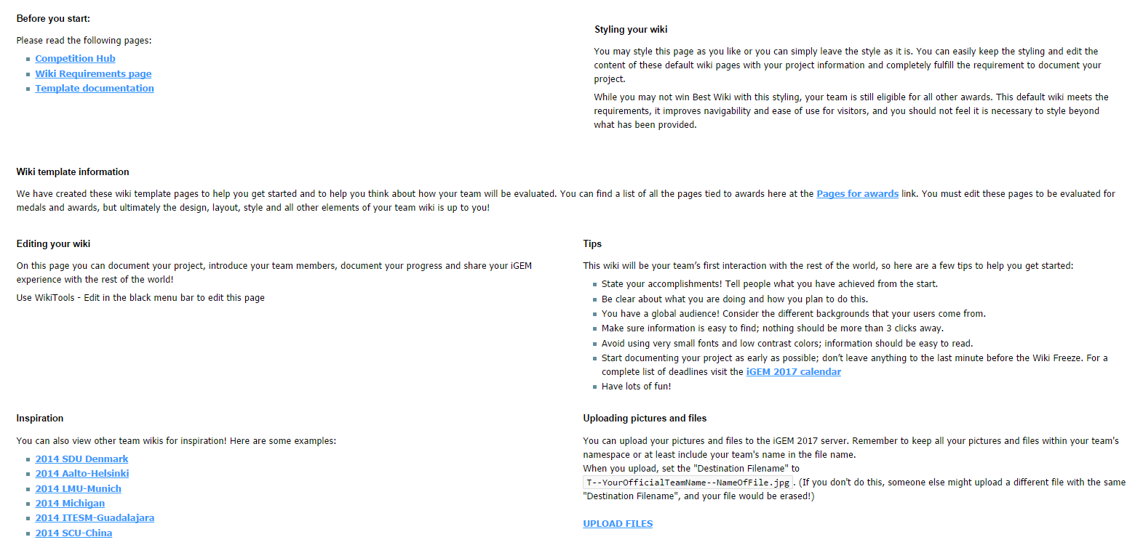
The Wiki
Record all information about the project on it – main source of information for judges about the project
Required pages include: project overview, team page, experimental design, results, parts, medal checklist, diary/notebook, lab book, team attributions…
http://2017.igem.org/Team:Newcastle/wiki_information

Slide 4
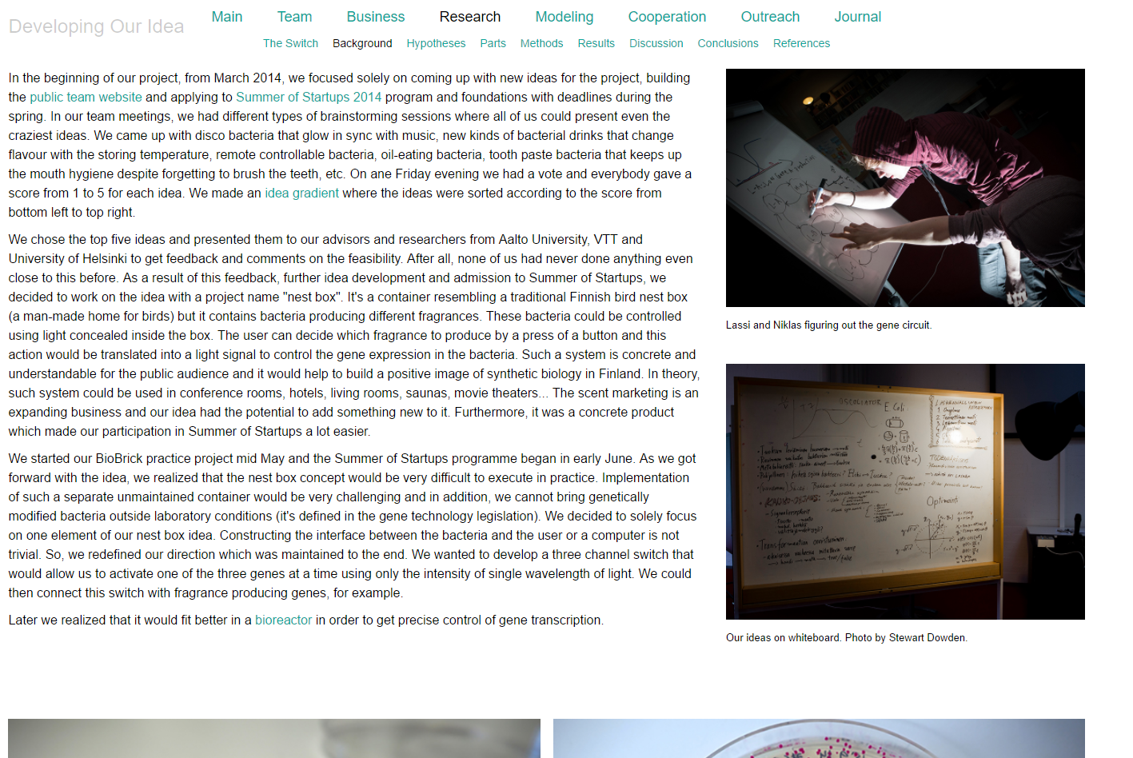
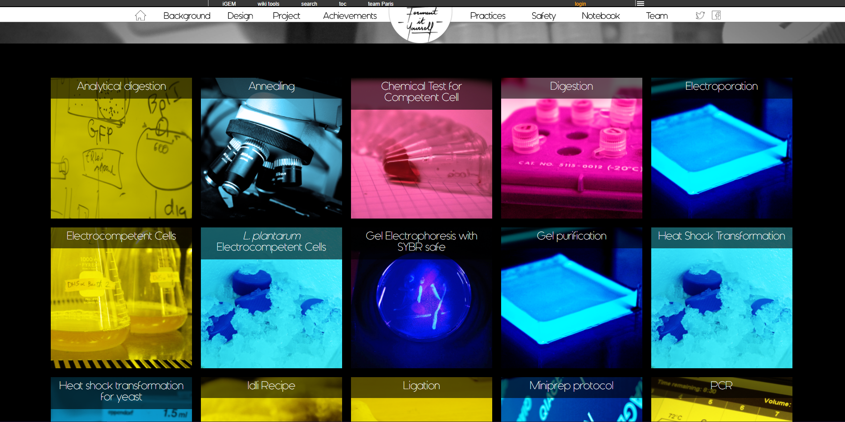
Wiki examples

Slide 5
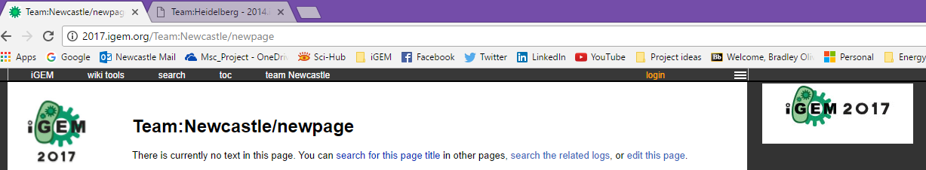
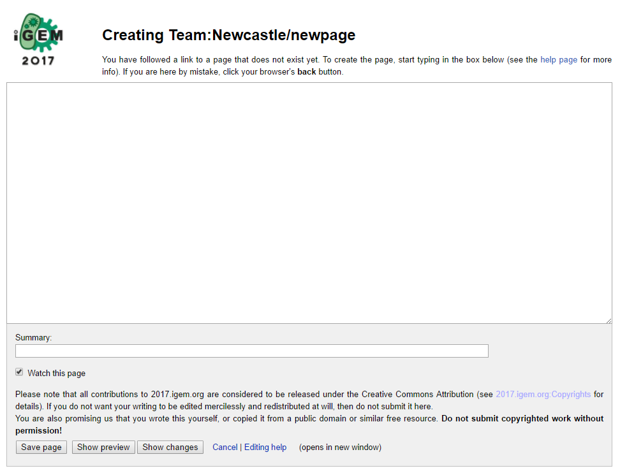
Editing the wiki
Create a new page by searching for it
Click ‘edit this page’ to start coding

Slide 6
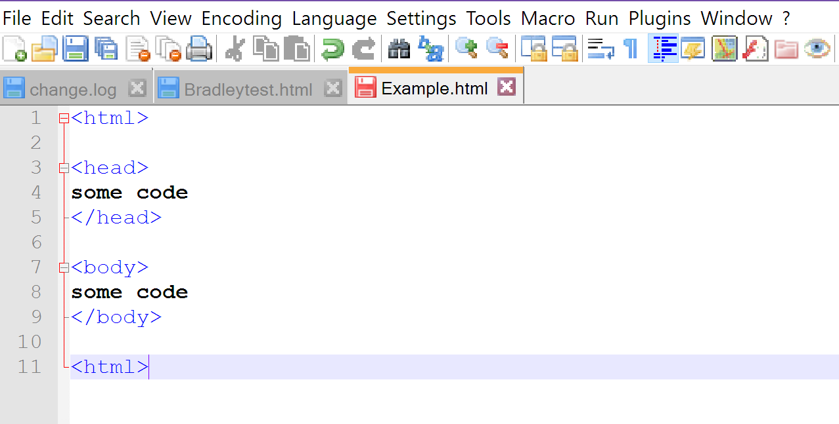
HTML – Setting up the page
Widely used in web development
Can be coded in any text editor – suggest notepad++ (or directly onto the wiki)
The page is set up using tags:
Use <tag> to start and </tag> to end
Note: start all of your wiki pages with {{Newcastle2}} before the <html> tag – this sets up an empty page without annoying wiki pre-formatting
<html> lets the browser know you are talking in HTML
The <head> section is normally used for linking to stylesheets, setting the web page title, and other meta data
The content of your webpage goes in the <body> section

Slide 7
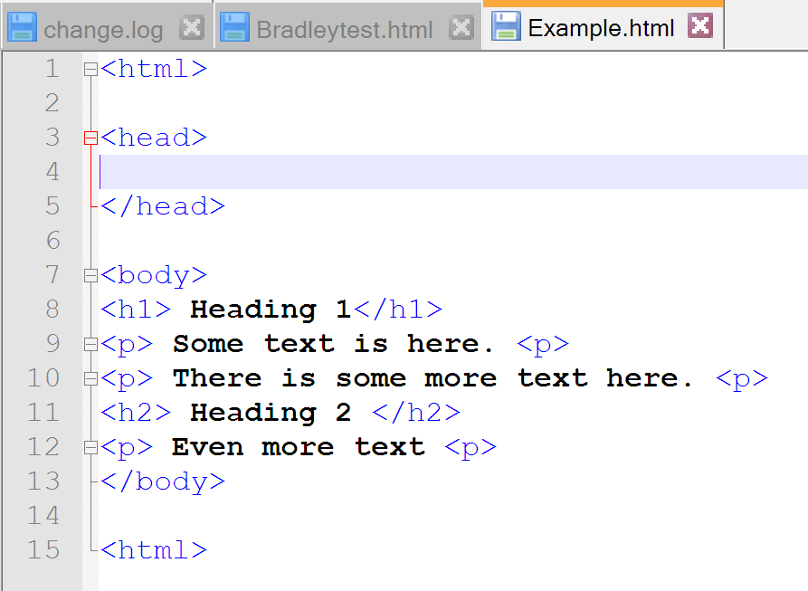
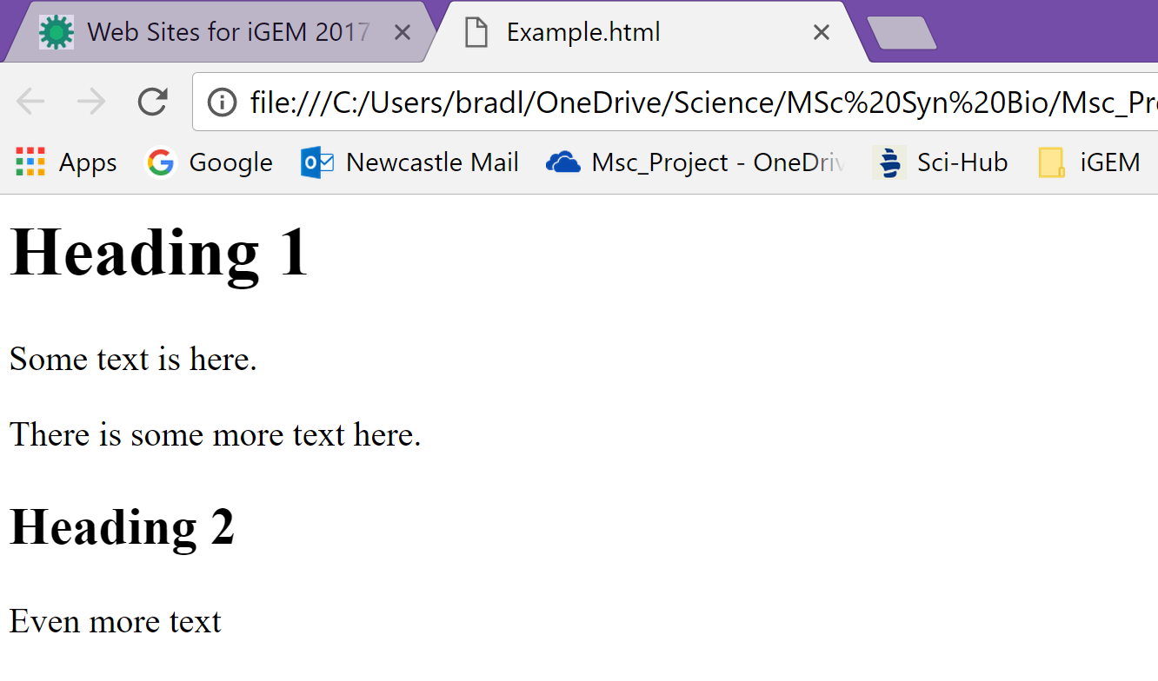
HTML –Writing and formatting text
Text goes between the <body> tags
Different types of text:
Use <h> tags with a number for headings – higher number = smaller text
Use <p> tags for ‘normal’ text

Slide 8
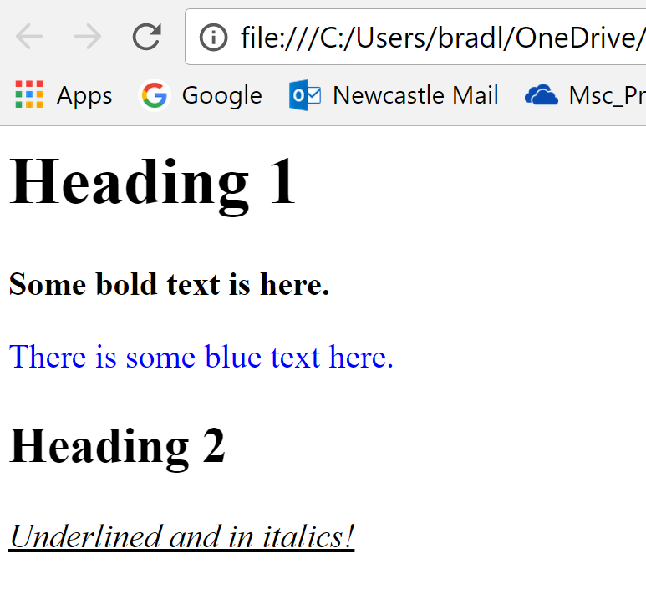
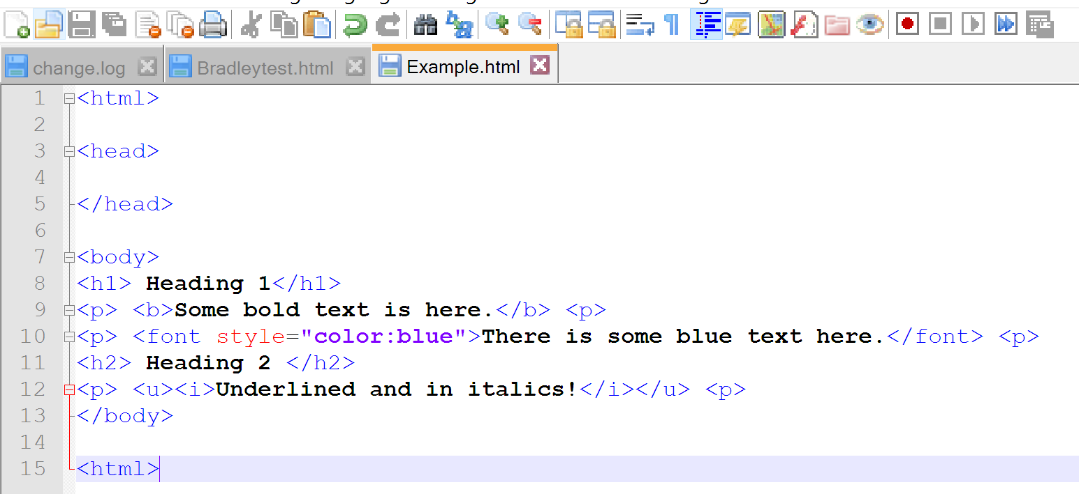
HTML –Writing and formatting text
Text can be made bold, italicised, underlined and coloured:
Note that it is color, not colour!
HTML always uses American spelling, e.g. center not centre
Other formatting, inserting images and more HTML is on the workshop sheet

Slide 9
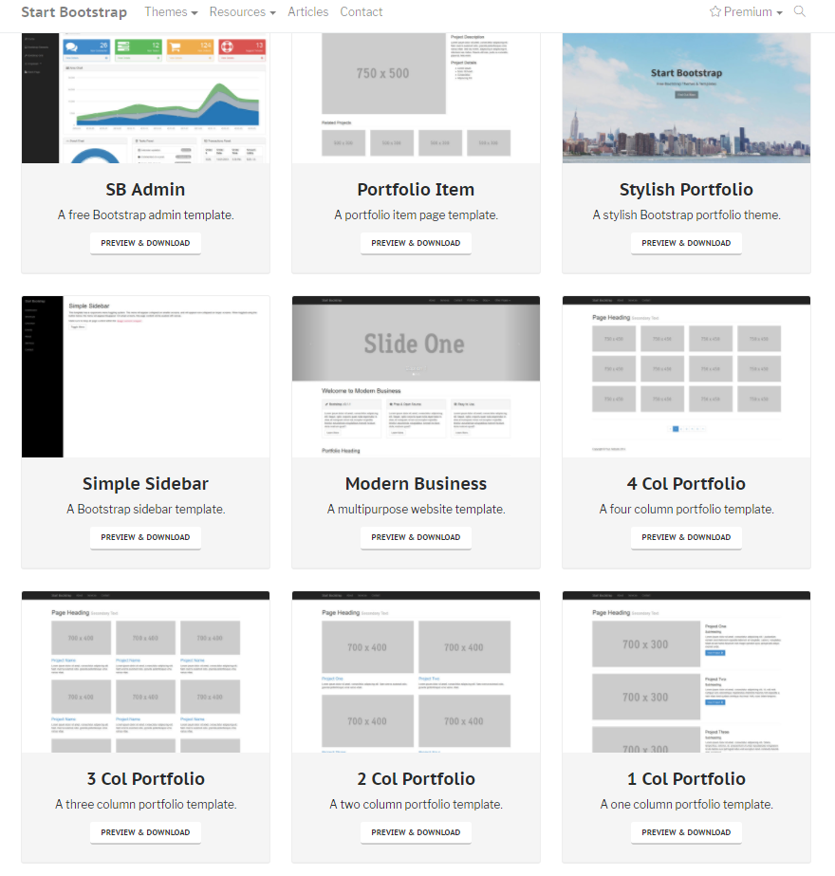
Bootstrap
Provides a style template for a website
Generally includes: a stylesheet, scripts, and a page layout template
Stylesheet: pre-styles text, tables, etc.
E.g. all text in <h1> tags is in Arial font, bold and dark blue
Scripts: used to make a webpage more functional
E.g. image carousels
Page layout template: general layout for the webpage:

Slide 10
Using the wiki
Already seen how to make a new page
Edit existing pages using the grey bar at the top:
You can also use ‘View’ to look at other team’s code

Slide 11
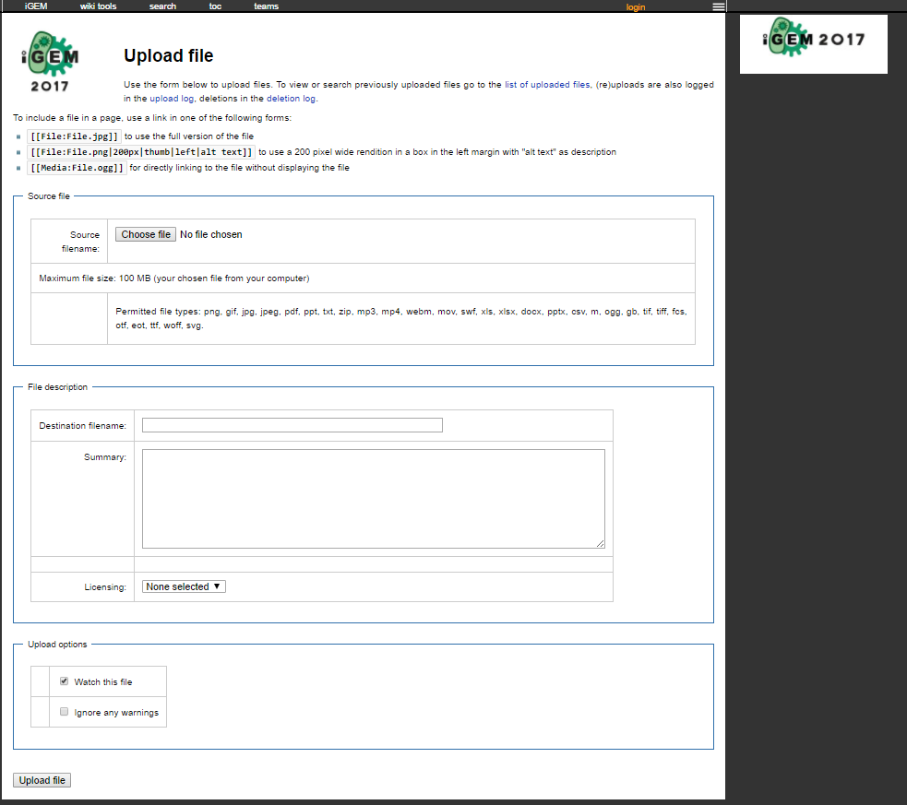
Using the wiki
Upload images also from the grey bar:
PDF files, word documents, presentations, etc. are uploaded in the same way; just give them the correct extension!
Compulsory image naming scheme:
T--Newcastle--FILENAME.ext
e.g.: T--Newcastle--Logo.png

Slide 12
Make a wiki page

